Slide 1


Slide 2
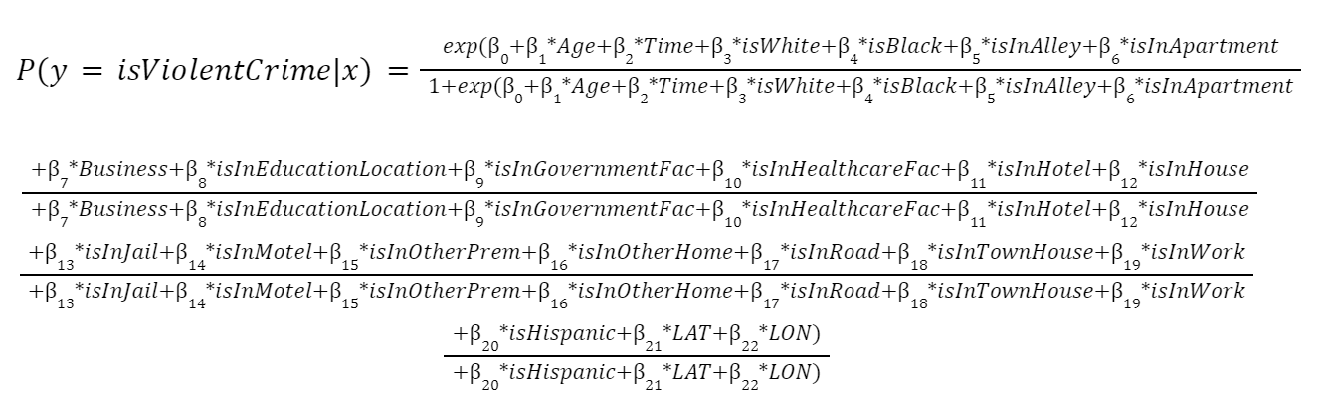
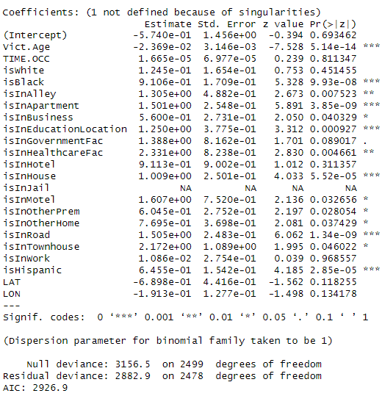
Logistic Regression Model
Contained 2,500 random samples from the data
Which predictors did we use: Age, time the crime occured, victim descent, victim premise, latitude, and latitude
Variables that are were not significant: Time occurred, latitude, longitude, and certain premises
Error Rate: 44.71653%
Method Used for finding this: 10-fold cross validation

Slide 3

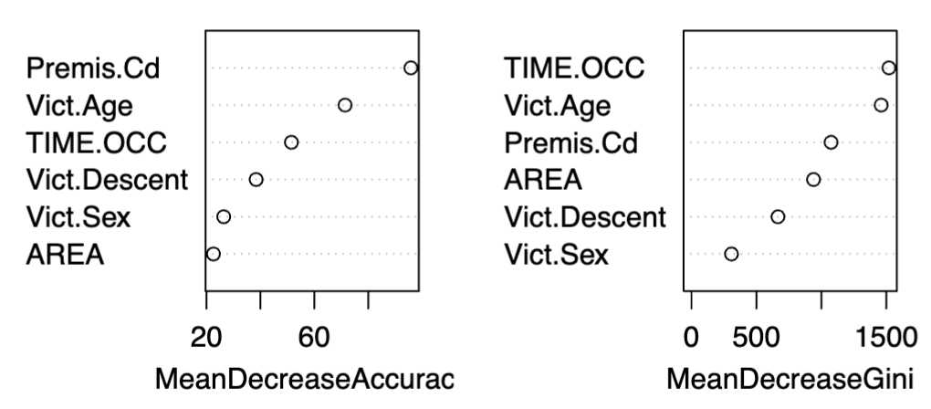
Random Forest Model
Key Advantages of Random Forests:
Handles categorical/numerical variables.
Reduces overfitting
Provides insights into variable importance.
Model Details:
Hyperparameters: 500 trees, mtry = √p.
Achieved mean test error of 25.11%.
Variable Importance:
Top predictors
  TIME.OCC (time of occurrence).
  Vict.Age (victim’s age).
  Premis.Cd (location type).

Slide 4

Conclusion
Which model to use
The random forest model is the better model. This is because the mean test error is much lower than the mean test error of the logistic regression model (23-26% compared to 43.7-44.7%).
Variable significance
Both models found that the age and premise of the victim was a highly significant variable in determine whether the crime was violent or not. Both models found that the area within Los Angeles was unimportant within determining whether the crime was violent or not

